Slide 1
Business Systems and Processes
Based on Ron Carroll’s blog
Κουτσομπίνας Κωνσταντίνος & Παπαδόπουλος Δημήτρης
11/5/2024

Slide 2
Business system
A system is a procedure, process, method, or course of action designed to achieve a specific result.
Its component parts and interrelated steps work together for the good of the whole.
Creating effective business systems is the only way to attain results that are consistent, measurable, and ultimately benefit customers.

Slide 3
Building Blocks of Business Success
Core Idea: Systems and processes are the foundational elements of any business.
Examples of business systems: Lead generation, customer service, sales, inventory management, etc.
A business system may be as simple as a checklist created in an hour or two. However, more complex systems can take days or even weeks to implement. The best systems consider such elements as design, components, people, quality, speed and measurement.

Slide 4
The "Magic Formula" for Success
Key elements: Eliminating waste, inefficiency and employee discretion, ensuring customer satisfaction.
Benefits: Streamlines operations, increases profitability, and enhances customer loyalty.
Michael Gerber said, "Organize around business functions, not people. Build systems within each business function. Let systems run the business and people run the systems. People come and go but the systems remain constant" (E-Myth Revisited, book).

Slide 5
A business
A business is made up of people, products, and processes organized to profitably find and keep customers.
Many companies fail because owners and managers are unable to create effective business processes that accomplish this fundamental objective.
So, what exactly is a business process?

Slide 6
Business process
There are business process experts who get deep in the weeds when defining a business process or trying to distinguish it from a business procedure or a business system.
However, for entrepreneurs and owners of small to midsize businesses, a few simple definitions will suffice for our discussion. →

Slide 7
Business process
Business Procedure – a sequence of actions taken to accomplish a task (emphasis on following steps in a specified order).
Business Process – a series of ordered activities that transform inputs into higher-value outputs (emphasis on transforming materials or information into a product or service).
Business System – a group of interacting, interrelated, or interdependent elements forming a unified whole (emphasis on related parts working together for a desired outcome).
A Process is Just a Recipe
Analogy: Like a recipe, processes have ingredients (resources) and steps (actions).
Consistency: Following these recipes ensures reliable results.
The only way to get a better process result is to improve the ingredients or the procedure of the recipe.

Slide 8
Types of Business Processes
Management Processes: Planning, organizing, controlling.
Operational Processes: Core activities like sales, production.
Supporting Processes: Tasks that support core processes, e.g., accounting, hiring.
Good business systems and processes have three primary purposes:
1) to attract customers, exceed their expectations and transform them into loyal fans,
2) to eliminate operational waste and inefficiencies that rob profit, and
3) to create differentiation and domination in your target market.

Slide 9
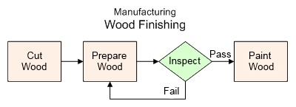
Describing a Process: Procedure vs. Checklist
A flowchart diagram with boxes and arrows—indicating steps, decision points, branches, and loops—sometimes makes it easier to describe a multi-path process than does a written procedure. Eg:
A checklist : When the steps in a process can be performed in any order, a simple "checklist" is all that is needed. Checklists are easy business systems that do not require flowcharts and can usually be created rather quickly.

Slide 10
Processes Are For Customers
Customers can be those who ultimately buy your products or services; however, business processes also serve the similar needs of your internal customers (e.g the next step in a business process is the customer of the previous step in that process.) In addition, employees are important customers of the business. They too have specifications (e.g. work hours, wages, and benefits) .
All of your business processes must deliver four basic things to its external and internal customers:
1) quality — low defects, does what is supposed to do,
2) speed — on schedule, meets deadlines, no delay,
3) low cost — high perceived value, competitively priced, and
4) pleasurable buying experience — no hassle, “killer customer care.”

Slide 11
Effective & Efficient Business Process Development
The process is built with the customer in mind.
The process represents “best practices” or your best-known way of doing something.
The business process is designed with one primary purpose
The system or process has an owner or team leader
There is ongoing and updated documentation on how to execute the process properly, including the handling of details and exceptions
The process is as simple as possible to get the job done, but not simpler.
There is a sufficient focus on system details to eliminate most bottlenecks, inefficiencies, delay, mistakes, defects, and rework.
The business system is not hampered by poor planning (lack of materials or labor) or stop-start work-flow as people switch between processes
The system has performance standards, and results are measured
Workers get ongoing feedback about system-performance and are recognized or rewarded for exceptional results.

Slide 12
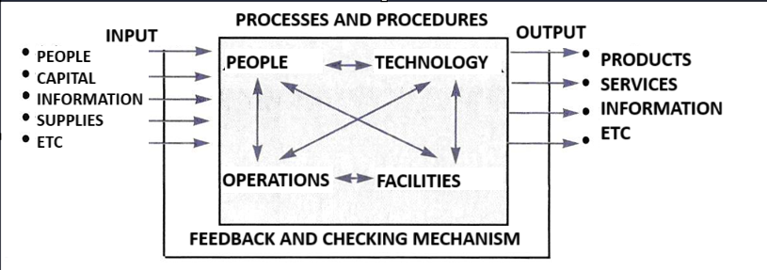
Business As A System
A business as a whole could also be considered as a complex system (with many subsystems and subprocesses) and, therefore, can be perceived and studied as such. It is clarified that a system is a set of elements or parts that are interconnected through interactive relationships and constitute a whole. According to the following figure business:
Receives inputs from the environment, including human, economic, material, and other resources.
Processes-transforms-refines these resources through various functions and means.
Provides outputs (e.g.products-services) to the environment.
Is distinct from its environment in the sense that it has boundaries.
Adapts to its environment through a control-feedback mechanism.

Slide 13
Wrapping Up
Final thoughts: Business systems and processes are crucial for sustainable growth.
Call to Action: Embrace systems thinking for business efficiency and competitive advantage.
Thank You

